Slide 1
Self Organizing Maps

Slide 2
Unsupervised Learningbased Neural Network
In a clustering net, there are as many units as the input vector has components.
Every output unit represents a cluster and the number of output units limit the number of clusters.
During the training, the network finds the best matching output unit to the input vector.
The weight vector of the winner is then updated according to learning algorithm.

Slide 3
Self Organization
The unsupervised weight adapting algorithms are usually based on some form of global competition between the neurons.
Applications of self-organizing networks are:

Slide 4
S.O. Applications
clustering: the input data may be grouped in `clusters' and the data processing system has to find these inherent clusters in the input data.

Slide 5
S.O. Applications
vector quantisation: this problem occurs when a continuous space has to be discretised. The input of the system is the n-dimensional vector x, the output is a discrete representation of the input space. The system has to find optimal discretisation of the input space.

Slide 6
S.O. Applications
dimensionality reduction: the input data are grouped in a subspace which has lower dimensionality than the dimensionality of the data. The system has to learn an “optimal” mapping.

Slide 7
S.O. Applications
feature extraction: the system has to extract features from the input signal. This often means a dimensionality reduction as described above.

Slide 8
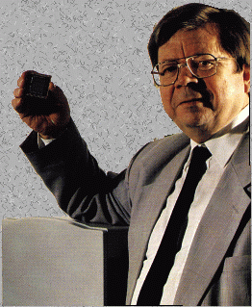
Self-Organizing Maps : Origins
Self-Organizing Maps
Ideas first introduced by C. von der Malsburg (1973), developed and refined by T. Kohonen (1982)
Neural network algorithm using unsupervised competitive learning
Primarily used for organization and visualization of complex data
Biological basis: ‘brain maps’
Teuvo Kohonen

Slide 9
Self Organizing Networks
Discover significant patterns or features in the input data
Discovery is done without a teacher
Synaptic weights are changed according to
local rules
The changes affect a neuron’s immediate environment until a final configuration develops

Slide 10
Concept of the SOM.
Input space
Input layer
Reduced feature space
Map layer
Ba
s₁
Mn
s₂
Sr
Cluster centers (code vectors)
Place of these code vectors in the reduced space
Clustering and ordering of the cluster centers in a two dimensional grid

Slide 11
Network Architecture
Two layers of units
Input: n units (length of training vectors)
Output: m units (number of categories)
Input units fully connected with weights to output units
Intra layer (lateral) connections
Within output layer
Defined according to some topology
Not weights, but used in algorithm for updating weights

Slide 12
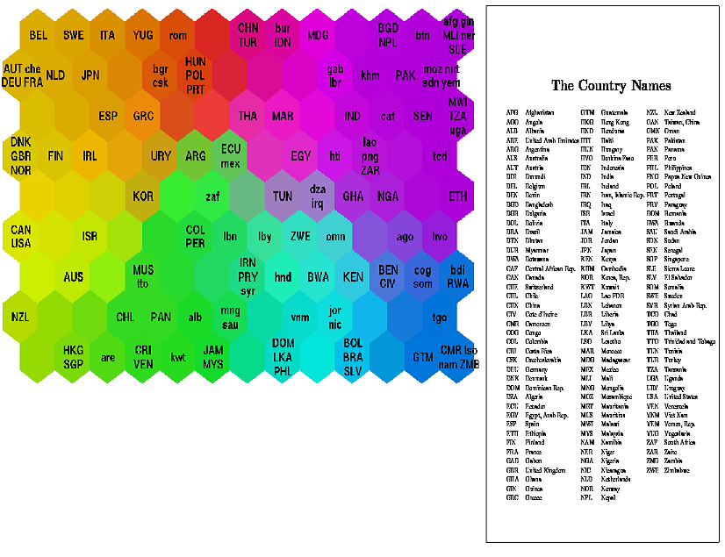
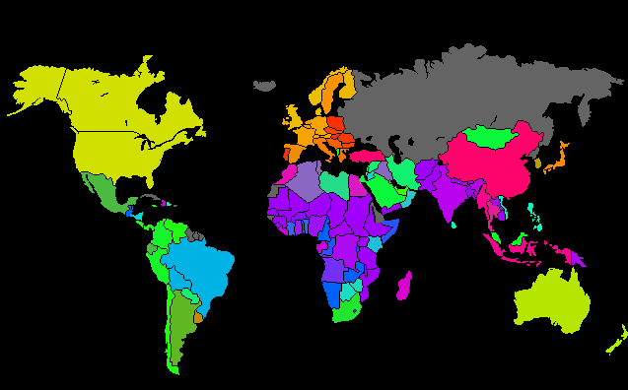
Self-Organizing Maps
SOM – Result Example
Helsinki University of Technology
Classifying World Poverty
‘Poverty map’ based on 39 indicators from World Bank statistics (1992)

Slide 13
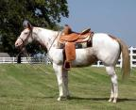

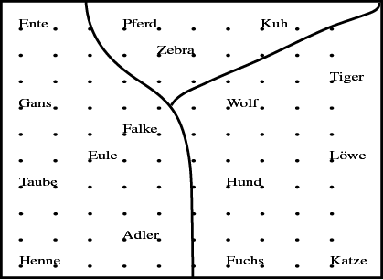

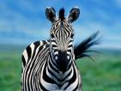


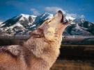







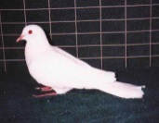
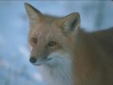
Example: Self-Organizing Maps
Animal names and their attributes
is
A grouping according to similarity has
emerged
has
peaceful
likes
to
birds
hunters
[Teuvo Kohonen 2001] Self-Organizing Maps; Springer;

Slide 14
Self Organizing Maps (SOM)
Applications of SOM
Customer segmentation
Bibliographic classification
Image-browsing systems
Medical diagnosis
Interpretation of seismic activity
Speech recognition
Data compression
Environmental modeling, many more …

Slide 15
Self-Organizing Networks
Learning Vector Quantization
Kohonen maps
Principal Components Networks
Adaptive Resonance Theory

Slide 16
Kohonen Maps
In the Kohonen network, the output units are ordered in some fashion, often in a two-dimensional grid or array, although this is application-dependent.

Slide 17
Kohonen Maps

Slide 18
Kohonen Maps
The input x is given to
all the units at the same
time

Slide 19
Kohonen Maps
The weights
of the winner unit
are updated
together with the weights of
its neighborhoods

Slide 20
KOHONEN SELF ORGANIZING MAPS
Architecture
neuron j
Kohonen layer
w_{j}
Winning neuron
Input vector X
X=[x₁,x₂,…x_{n}] ∈ R^{n}
w_{ij}=[w_{1j},w_{2j},…,w_{nj}] ∈ R^{n}

Slide 21
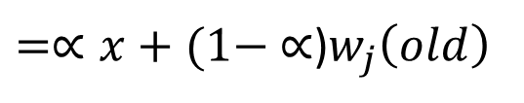

Kohonen Learning
A variety of nets use Kohonen Learning
New weight vector is the linear combination of old weight vector and the current input vector.
The weight update for cluster unit (output unit) j can be calculated as:
the learning rate (alpha) decreases as the learning process proceeds.
$w_{j}\left(new\right)=w_{j}\left(old\right)+ {∝[ x−w}_{j}\left(old\right)]$
$=∝x+(1− ∝$)$w_{j}\left(old\right)$

Slide 22
Kohonen SOM (Self Organizing Maps)
Normally, Euclidean distance measure is used to find the cluster unit whose weight vector matches most closely to the input vector.
For a linear array of cluster units, the neighborhood of radius R around cluster unit J consists of all units j such that:

Slide 23
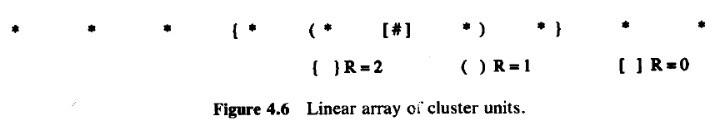
Kohonen SOM (Self Organizing Maps)
Structure of Neighborhoods

Slide 24
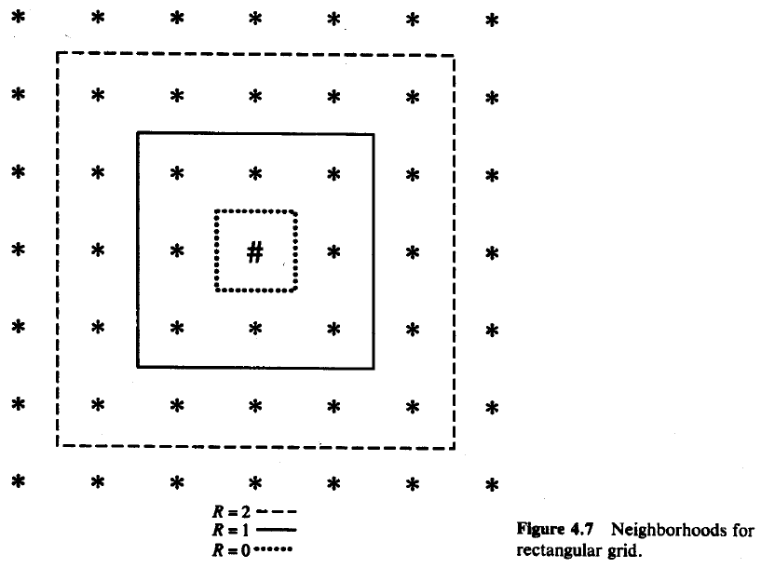
Kohonen SOM (Self Organizing Maps)
Structure of Neighborhoods

Slide 25
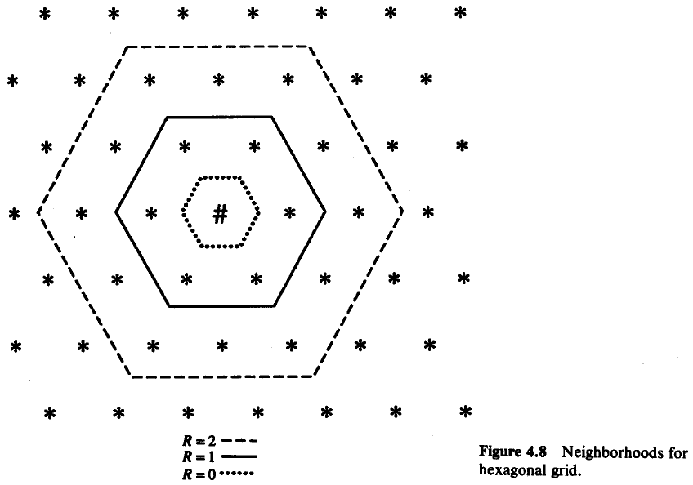
Kohonen SOM (Self Organizing Maps)
Structure of Neighborhoods

Slide 26
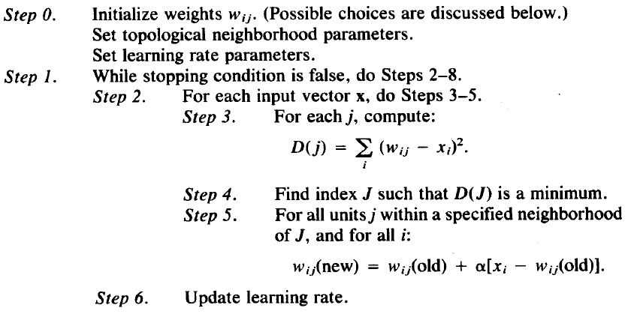
Kohonen SOM (Self Organizing Maps)
Neighborhoods do not wrap around from one side of the grid to other side which means missing units are simply ignored.
Algorithm:

Slide 27
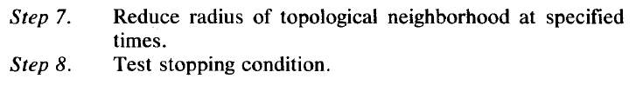
Kohonen SOM (Self Organizing Maps)
Algorithm:
Radius and learning rates may be decreased after each epoch.
Learning rate decrease may be either linear or geometric.

Slide 28
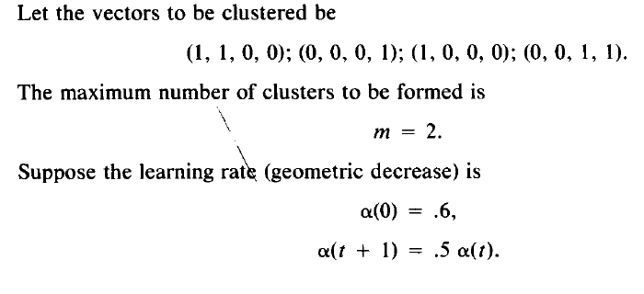
Kohonen SOM (Self Organizing Maps)
Example

Slide 29
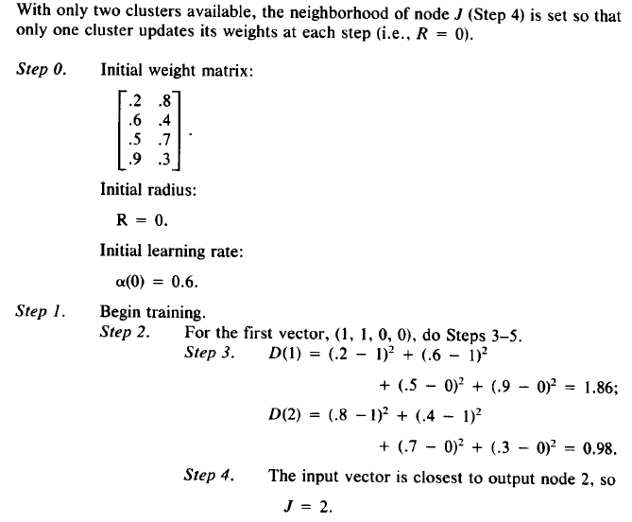
Kohonen SOM (Self Organizing Maps)

Slide 30
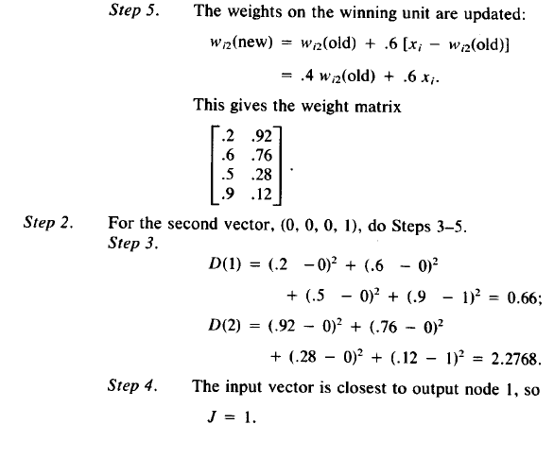
Kohonen SOM (Self Organizing Maps)

Slide 31
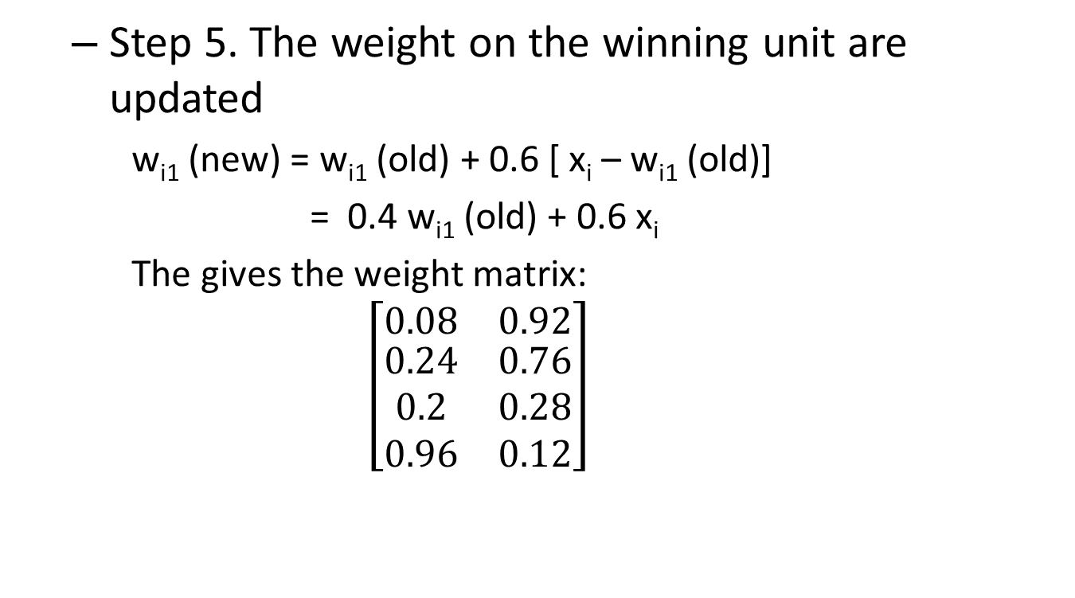
Kohonen SOM (Self Organizing Maps)
Step 5. The weight on the winning unit are updated
w_{i1} (new) = w_{i1} (old) + 0.6 [ x_{i} – w_{i1} (old)]
= 0.4 w_{i1} (old) + 0.6 x_{i}
The gives the weight matrix:
$$\left[\begin{matrix}0.08 & 0.92 \\ \begin{aligned}0.24 \\ 0.2 \\ 0.96\end{aligned} & \begin{aligned}0.76 \\ 0.28 \\ 0.12\end{aligned}\end{matrix}\right]$$

Slide 32
Kohonen SOM (Self Organizing Maps)
Step 2. For the third vector (1, 0, 0, 0) do step 3-5
Step 3
D(1) = (0.08-1)² + (0.24-0)² + (0.2-0)² + (0.96-0)²=
= 0.9872 + 0.0576 + 0.04 + 0.9216 = 2.006
D(2) = (0.92-1)² + (0.76-0)² + (0.28-0)² + (0.12-0)²=
= 0.0064 + 0.5776 + 0.0784 + 0.0144 = 0.6768
Step 4 The input vector is closest to output node 2, so J = 2

Slide 33
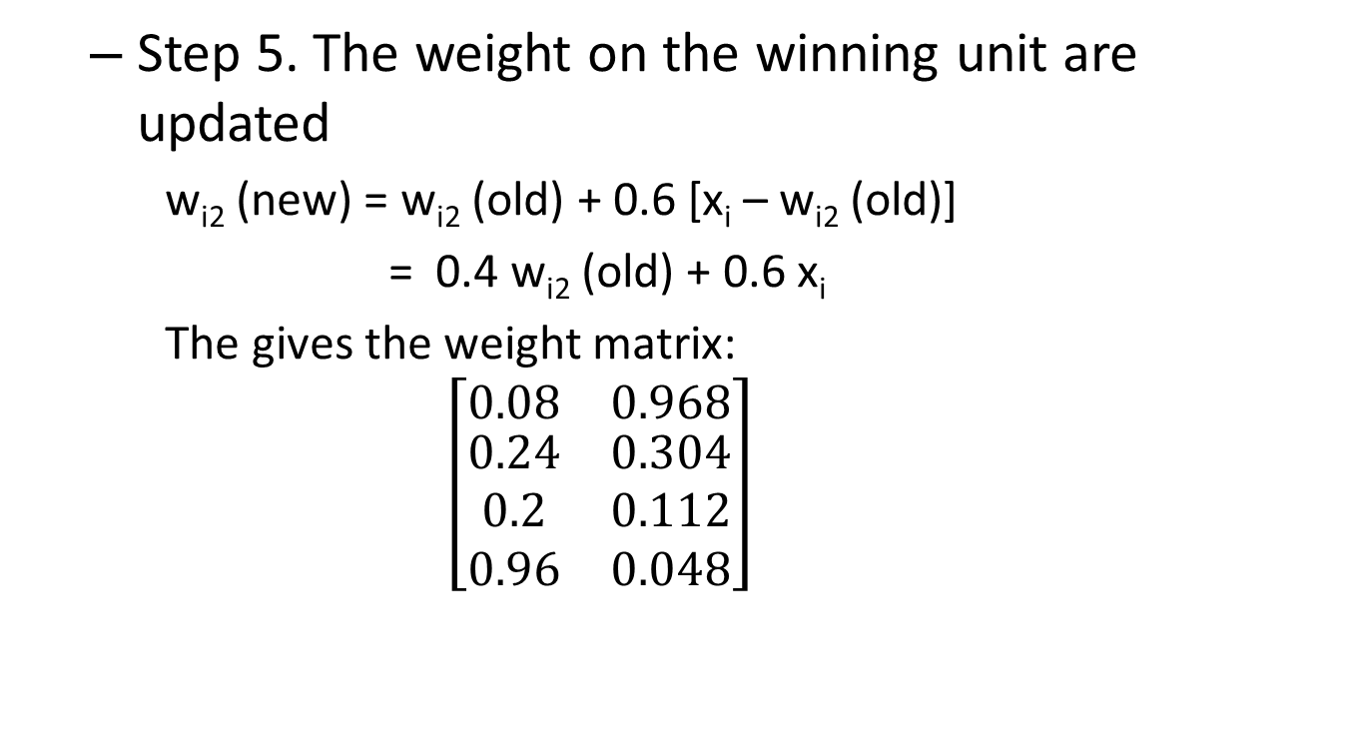
Kohonen SOM (Self Organizing Maps)
Step 5. The weight on the winning unit are updated
w_{i2} (new) = w_{i2} (old) + 0.6 [x_{i} – w_{i2} (old)]
= 0.4 w_{i2} (old) + 0.6 x_{i}
The gives the weight matrix:
$$\left[\begin{matrix}0.08 & 0.968 \\ \begin{aligned}0.24 \\ 0.2 \\ 0.96\end{aligned} & \begin{aligned}0.304 \\ 0.112 \\ 0.048\end{aligned}\end{matrix}\right]$$

Slide 34
Kohonen SOM (Self Organizing Maps)
Step 2. For the fourth vector (0, 0, 1, 1) do step 3-5
Step 3
D(1) = (0.08-0)² + (0.24-0)² + (0.2-1)² + (0.96-1)²=
= 0.0064 + 0.0576 + 0.64 + 0.0016 = 0.7056
D(2) = (0.968-0)² + (0.304-0)² + (0.112-1)² + (0.048-1)²=
= 0.937 + 0.0924 + 0.7885 + 0.9063 = 2.724
Step 4 The input vector is closest to output node 1, so J = 1

Slide 35
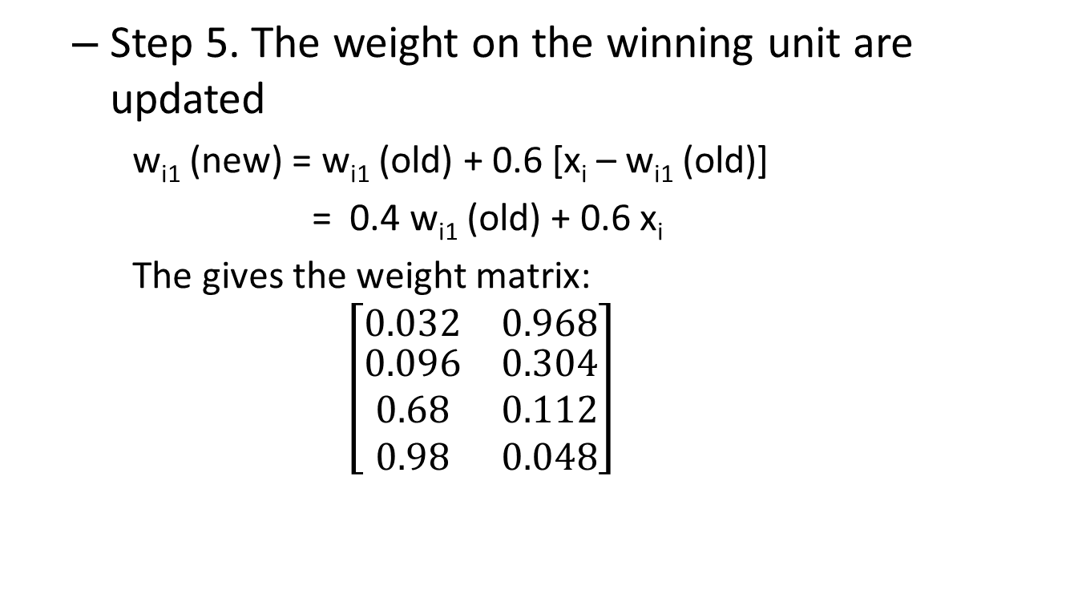
Kohonen SOM (Self Organizing Maps)
Step 5. The weight on the winning unit are updated
w_{i1} (new) = w_{i1} (old) + 0.6 [x_{i} – w_{i1} (old)]
= 0.4 w_{i1} (old) + 0.6 x_{i}
The gives the weight matrix:
$$\left[\begin{matrix}0.032 & 0.968 \\ \begin{aligned}0.096 \\ 0.68 \\ 0.98\end{aligned} & \begin{aligned}0.304 \\ 0.112 \\ 0.048\end{aligned}\end{matrix}\right]$$

Slide 36
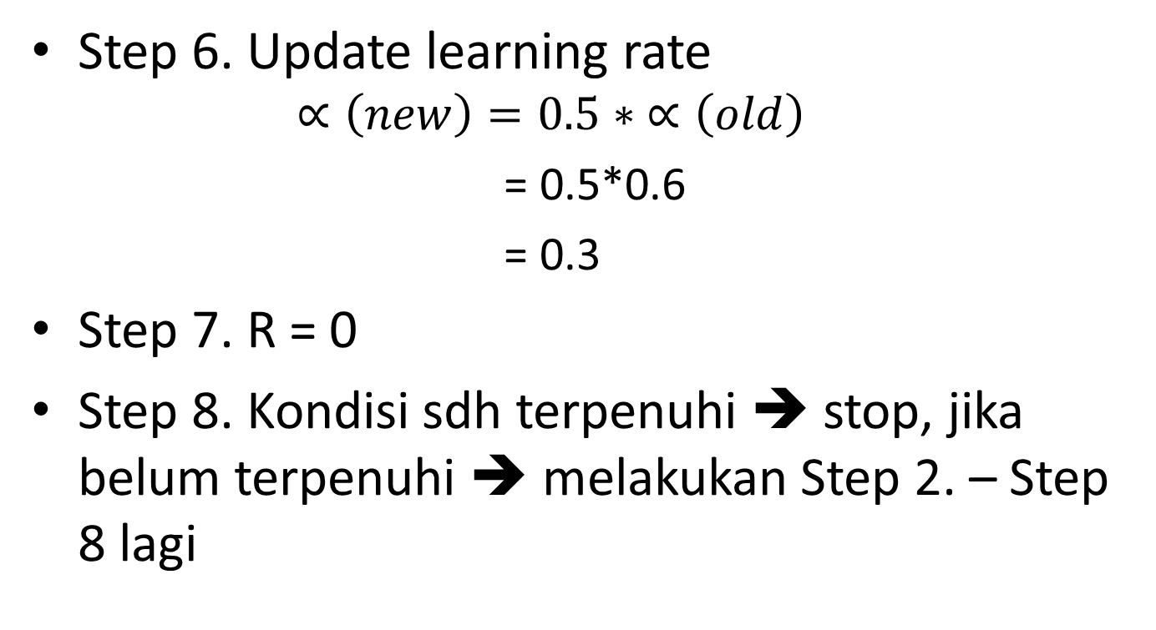
Kohonen SOM (Self Organizing Maps)
Step 6. Update learning rate
$$∝\left(new\right)=0.5∗ ∝\left(old\right)$$
= 0.5*0.6
= 0.3
Step 7. R = 0
Step 8. Kondisi sdh terpenuhi ➔ stop, jika belum terpenuhi ➔ melakukan Step 2. – Step 8 lagi

Slide 37
Example
An SOFM network with three inputs and two cluster units is to be trained using the four training vectors:
[0.8 0.7 0.4], [0.6 0.9 0.9], [0.3 0.4 0.1], [0.1 0.1 02]
and initial weights:
The initial radius is 0 and the learning rate is 0.5 .
Calculate the weight changes during the first cycle through the data, taking the training vectors in the given order.
0.5
0.6
weights to the first cluster unit
0.8

Slide 38
Solution
The distance of the input vector 1 to cluster unit 1 is:
The distance of the input vector 1 to cluster unit 2 is:
Input vector 1 is closest to cluster unit 1 so update weights to cluster unit 1:

Slide 39
Solution
The distance of the input vector 2 to cluster unit 1 is:
The distance of the input vector 2 to cluster unit 2 is:
Input vector 2 is closest to cluster unit 1 so update weights to cluster unit 1 again:

Slide 40
Solution
The distance of the input vector 3 to cluster unit 1 is:
The distance of the input vector 3 to cluster unit 2 is:
Input vector 3 is closest to cluster unit 2 so update weights to cluster unit 2 again:

Slide 41
Solution
The distance of the input vector 4 to cluster unit 1 is:
The distance of the input vector 4 to cluster unit 2 is:
Input vector 4 is closest to cluster unit 2 so update weights to cluster unit 2 again:

Slide 42
Material Resources
Jing Li, Information Visualization with Self-Organizing Maps , Course slides presentation
Dr. Abdul Basit Siddiqui, Artificial Neural Networks, Course slides presentation
Richard O. Duda, et. al, Pattern Classification 2nd Edition, John Wiley & Sons, Inc., 2001

